Slide 1

Pipeline Patterns and Antipatterns
By Anish Jain
Build Better Pipelines: Patterns for Success, Antipatterns for Distress!

Slide 2
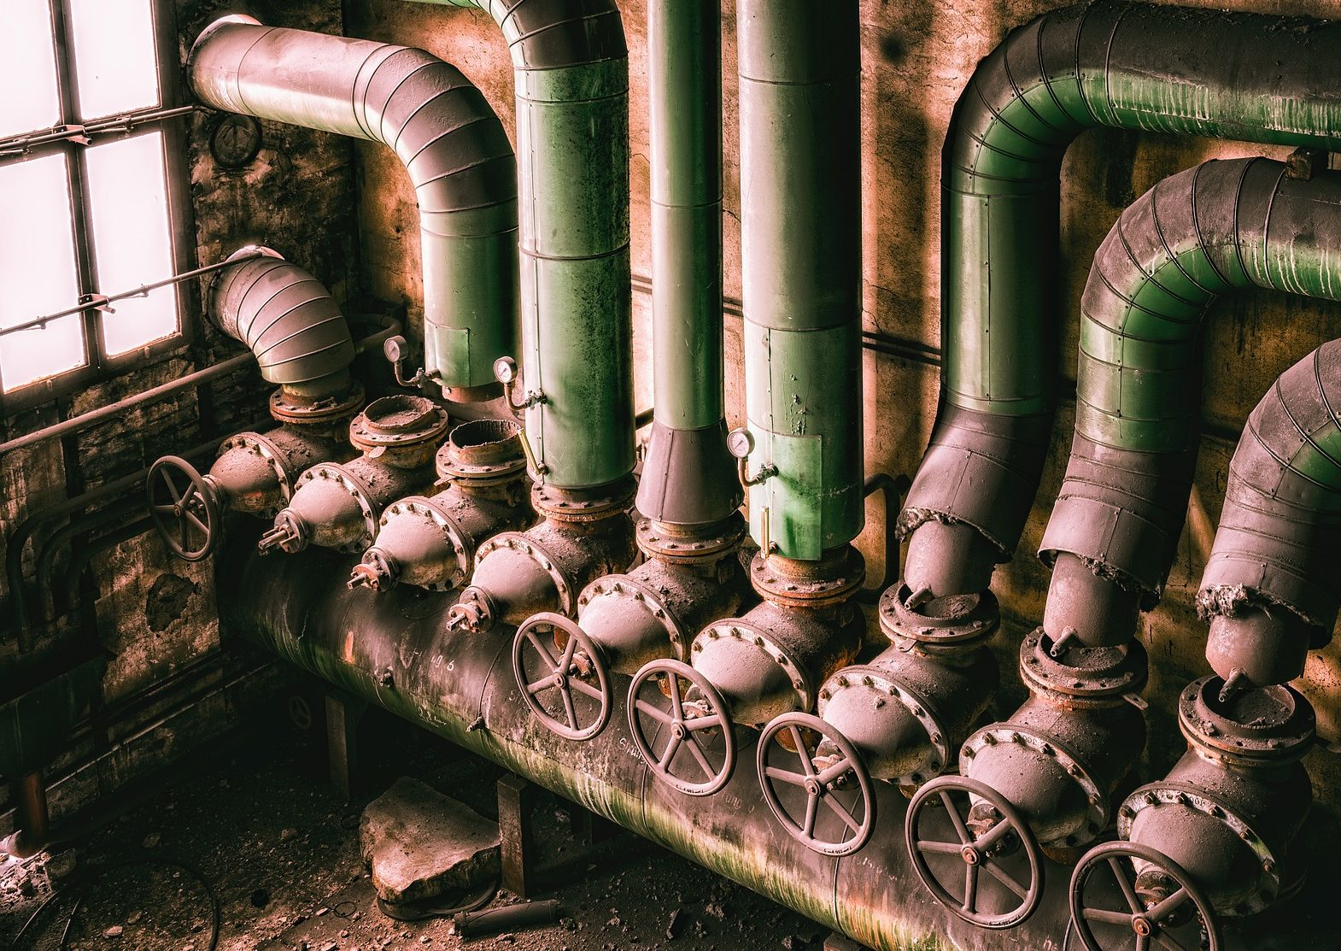
Agenda
#1 Anti-Pattern – The Ritual
- The right pipeline for the job
#2 Conditional pipeline steps
#3 Anti-Pattern – The Aesthete
- Failing fast
#4 Anti-Pattern – The one pipeline
- Parallel pipelines
#5 Anti-Pattern – Gift wrapping
#6 Composable pipeline library
#7 Anti-Pattern: Entangled
CI/CD Antipatterns for K8s
K8s deployment strategies
Phases of Maturity

Slide 3

Let’s start

Slide 4
#1 Anti-Pattern – The Ritual
PR
Backend setup
Backend lint
Backend tests
Frontend setup
Frontend lint
Frontend tests
Integration tests
Merge (main)
Backend setup
Backend lint
Backend tests
Frontend setup
Frontend lint
Frontend tests
Integration tests
Nightly
Backend setup
Backend lint
Backend tests
Frontend setup
Frontend lint
Frontend tests
Integration tests

Slide 5
The right pipeline for the job
PR
Backend setup
Backend lint
Backend tests
Frontend setup
Frontend lint
Frontend tests
Integration tests
Merge (main)
Backend setup
Backend tests
Frontend setup
Frontend tests
Integration tests
Publish artifact
Nightly
Backend setup
Frontend setup
Integration tests

Slide 6
#2 Conditional pipeline steps
PR
Backend setup
Backend lint
Backend tests
Frontend setup
Frontend lint
Frontend tests
Integration tests

Slide 7
Conditional pipeline steps
PR
Backend setup
Frontend setup
Frontend lint
Frontend tests
Integration tests
PR
Backend setup
Backend lint
Backend tests
Frontend setup
Integration tests

Slide 8
#3 Anti-Pattern – The Aesthete
Build
setup
Lint
Compile
Unit tests
Integration tests
E2E tests
13 m 37 s
33 s
2 m 42 s
5 m 14 s
52 s
4 m 16 s
If something fails, we will be notified about it after 13 minutes.
70% of pipeline failures are due to integration test failures.

Slide 9
Failing fast
Build
setup
Compile
Integration tests
10 m 3 s
33 s
5 m 14 s
4 m 16 s

Slide 10
#4 Anti-Pattern – The one pipeline
Backend setup
Backend lint
Backend Compile
Backend tests
Frontend setup
Frontend lint
Frontend Compile
Frontend tests
Integration tests
24 m 40 s
33 s
2 m 42 s
5 m 14 s
52 s
1 m 8 s
1 m 53 s
2 m 12 s
3 m 26 s
6 m 41 s
You cannot request a review of your PR until the pipeline completes.

Slide 11
Parallel pipelines
Backend setup
Backend lint
Backend Compile
Backend tests
9 m 21 s
We can now run the pipeline in parallel.
We have saved 10 minutes.
Running the compilation twice has added 8 minutes to the total runtime, making it worse for the environment.
33 s
2 m 42 s
5 m 14 s
52 s
Frontend setup
Frontend lint
Frontend Compile
Frontend tests
8 m 39 s
1 m 8 s
1 m 53 s
2 m 12 s
3 m 26 s
Backend setup
Backend Compile
Frontend setup
Frontend Compile
Integration tests
14 m 48 s
33 s
5 m 14 s
1 m 8 s
2 m 12 s
6 m 41 s

Slide 12
Parallel pipelines
Backend setup
Backend lint
Backend Compile
Backend tests
Publish artifact
9 m 28 s
The integration test relies on the UI and backend pipeline, adding 1 minute to the runtime.
33 s
2 m 42 s
5 m 14 s
52 s
7s
Integration test
16 m 9 s
Frontend lint
Frontend tests
Publish artifact
6 m 41 s
Frontend setup
Frontend Compile
8 m 47 s
1 m 8 s
1 m 53 s
2 m 12 s
3 m 26 s
8 s

Slide 13
Parallel pipelines
Backend setup
Backend Compile
Publish artifact
Backend lint
Backend tests
9 m 28 s
We can now split this into 5 pipelines.
It all depends on how many build servers you have. If you have only one build server, then you are out of luck.
This brings the time down to 12 minutes.
If you are using the cloud, you have an infinite number of build servers which can run your pipelines in parallel.
33 s
5 m 14 s
7 s
2 m 42 s
52 s
Integration tests
12 m 35 s
6 m 41 s
Frontend setup
Frontend Compile
Publish artifact
Frontend lint
Frontend tests
8 m 47 s
1 m 8 s
1 m 53 s
8 s
1 m 53 s
3 m 26 s

Slide 14
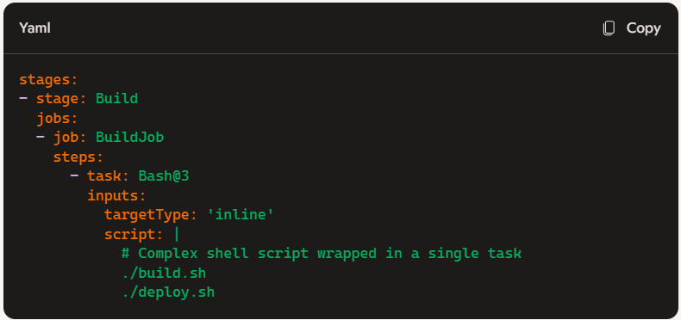
#5 Anti-Pattern – Gift wrapping
Scenario:
Imagine you have a complex shell script that performs multiple steps to build and deploy an application. Instead of breaking down the script into smaller, manageable tasks, you wrap the entire script within a single "Execute Shell" task in your pipeline.
Issues with This Approach:
Maintainability: The entire script is contained within a single task, making it difficult to manage and update.
Reusability: The script cannot be easily reused in other parts of the pipeline or in different pipelines.
Debugging: Debugging becomes challenging as you have to sift through a large block of code to identify issues.

Slide 15
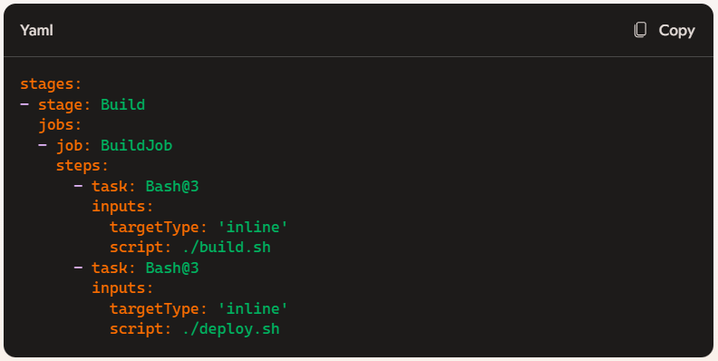
Gift wrapping
Better Approach:
Break down the complex shell script into smaller, reusable tasks and use them within your pipeline. This improves maintainability, reusability, and debugging.
Sometimes, command line tools won't work due to their limited scope; instead, you must directly call the application via a command.
I don't mean to avoid tasks entirely; rather, avoid using wrapper pipeline tasks.

Slide 16
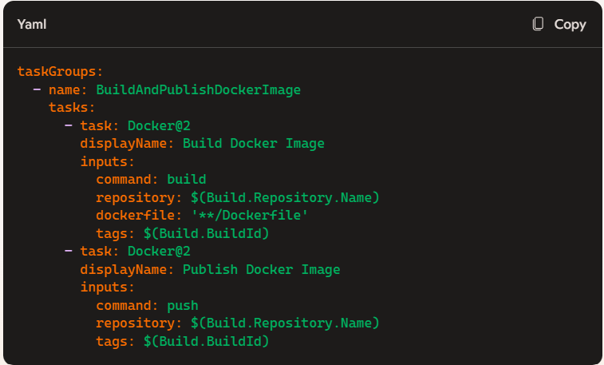
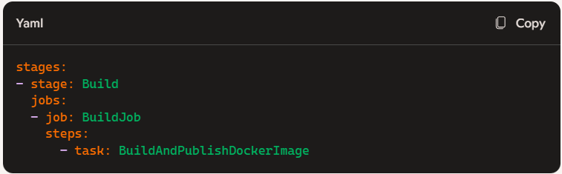
#6 Composable pipeline library
A composable pipeline library is a collection of modular, reusable components or tasks that can be combined and configured to create complex CI/CD pipelines. The idea is to allow developers to build pipelines by composing smaller, manageable pieces rather than creating monolithic, hard-to-maintain scripts.
Let's say we have 30 projects that share the same pipeline.
We can add parameters to customize our pipeline.
It is very easy to create a copy of the composable pipeline and add your own tasks to it.
This approach is really useful when you do not want to implement it from scratch.

Slide 17
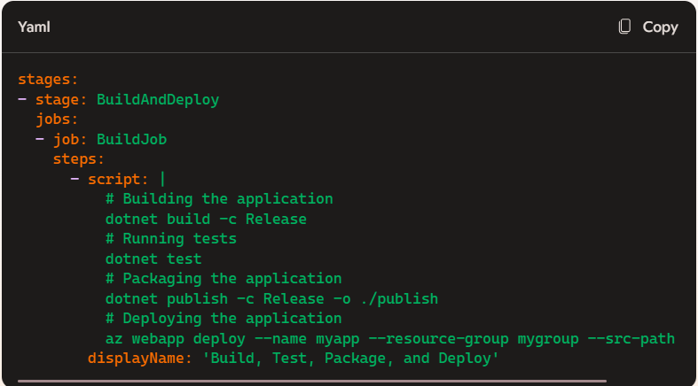
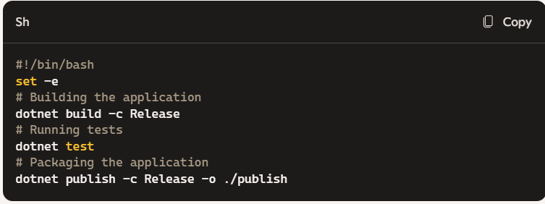
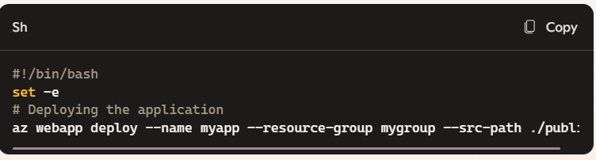
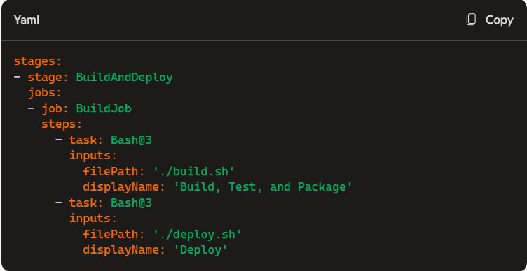
#7 Anti-Pattern: Entangled
The Entangled anti-pattern refers to the practice of tightly coupling your build logic to a specific build system. This can lead to significant challenges when you need to migrate to another system or make changes to your pipeline. Here are the details and an example to help clarify this concept:
Solution: Decouple Your Logic
Use Script Files: Instead of embedding all logic within the build system, use external scripts (e.g., Shell, PowerShell, Python) to handle complex tasks. This makes your pipeline more portable and easier to maintain.
Leverage Build System Features Sparingly: Use the build system's features for orchestrating tasks and basic operations but avoid deeply integrating your logic.
Advantages & process:
By using scripts, we can run them locally and see the results, which isn't possible with tasks within the pipeline.
Put your complex logic in scripts.
For example, when running integration tests, we can first test them locally using a PowerShell script. Once verified, we can run the same script in Azure DevOps, with a high likelihood of success. This approach results in a faster feedback loop.

Slide 18
CI/CD Antipatterns for K8s
Mixing Build and Runtime Environments: Using the same Docker image for both building and running applications. This can lead to bloated images and security issues.
Using Latest Tags for Docker Images: Using the "latest" tag for Docker images can lead to unpredictable deployments. Always use specific tags for reproducibility.
Ad-Hoc Deployments with kubectl: Performing manual deployments using kubectl commands can lead to inconsistencies and lack of traceability.
Not Using Helm: Helm is a package manager for Kubernetes that simplifies managing deployments. Not using Helm can lead to complex and hard-to-maintain deployments.
Ignoring Resource Limits: Not setting CPU and memory limits for pods can lead to resource contention and degraded performance.

Slide 19

Any Questions?

Slide 20

Thank You

